Slide 1

ANALYSIS REPORT
PRESENTED BY:
Ashish Kothari
Crisel Dsilva
Naveen Bhatt

Slide 2

INTRODUCTION
Insurance industry is a vital sector that provides financial protection against various risks by transferring and sharing those risks among a group of individuals. It acts as a safety net for individuals and businesses, safeguarding them from potential financial losses due to events like accidents, illness, or property damage. Insurance also plays a crucial role in economic development by encouraging savings and providing long-term funds for infrastructure projects.
Benefits of insurance
Cashless treatments/Coverage on pre-existing diseases/Critical illness coverage/Customized healthcare
Tax benefits
Financial security
Retirement planning
Investment opportunities
Wealth creation
Peace of mind
Insurance Sector
Non - Life Insurance/General Insurance(≈30% Market Share)
Health Insurance
Motor Insurance
Life Insurance(≈70% Market Share)
Fire Insurance
Disaster Insurance
Other General Insurance

Slide 3

DATA OVERVIEW
Data is uncleaned and structured across seven excel workbooks from which six excel workbooks contains primary data in tables, each serving a specific operational function. It’s ensures effective management, reporting, and decision-making across client engagement, revenue tracking, budgeting, and sales.
Table Name | Description | Purpose | Key Fields | Use Case | No. of Rows
Brokerage | Core Policy Management | Tracks detailed policy information for each client | Client Name, Policy Number, Policy Status, Start/End dates, Product Group, Income, Renewal Status, Account Executive ID | Monitor policy lifecycle Financial performance Renewal outcomes | 961
Fees | Revenue from Fees | Records all fee-based revenue transactions | Client Name, Branch Name, Income Class, Amount, Income Due Date, Account Executive ID | Identify income sources Track overdue payments Support financial reporting | 9
Budget | Internal Resource Allocation | Manages budget planning for roles and initiatives | Branch, Employee Name, New Role, New Budget, Cross-sell Budget, Renewal Budget, Account Executive ID | Plan and track budgeting efforts Align staff resources to revenue goals | 10
Invoice | Billing and Accounts | Details transactions that generate invoices | Invoice Number, Invoice Date, Revenue Transaction Type, Policy Number, Amount, Account Executive ID | Invoice tracking Revenue recognition Reconciliation with accounting systems. | 204
Meeting | Engagement Tracking | Logs meetings between account executives and clients or teams | Account Executive, Branch Name, Global Attendees, Meeting Date, Account Executive ID | Track engagement frequency Team collaboration efforts | 34
Opportunity | Sales and Pipeline Management | Tracks potential revenue opportunities | Opportunity Name, Opportunity ID, Stage, Closing Date, Premium Amount, Risk Details, Account Executive ID | Sales forecasting Pipeline management Opportunity evaluation | 49

Slide 4
OBJECTIVES: KPI’S
Cross-Sell / New / Renewal (Target, Achieved, New) #Each of these sub-KPIs shares a structure but applies to different business growth strategies:
✅ Cross-Sell → 🎯 Objective: Encourage maximization of client value through multi-product engagement.
No. of Invoices by Account Executive
Yearly Meeting Count
🎯 Objective: Monitor client engagement levels through meetings over the year.
Target: Expected income or policies from selling additional products to existing clients.
Achieve: Actual cross-sell performance.
New: New cross-sell opportunities created.
🆕 New Business → 🎯 Objective: Track growth from acquiring new customers or business lines.
Target: New clients or policies planned.
Achieve: Actuals compared to the target.
New: Recently added prospects or opportunities.
🔁 Renewal → 🎯 Objective: Maintain existing book of business and reduce churn.
Target: Renewal targets for existing policies.
Achieve: Renewals completed successfully.
New: Newly entered renewal opportunities (e.g., upcoming renewals).
Why it matters?
Helps assess relationship-building efforts.
Higher meetings can correlate with client retention and upselling success.
Can highlight under-engagement risks.
No. of Meetings by Account Executive → (Similar to #2 but broken down by individual)
🎯 Objective: Evaluate the individual client-facing activity of each Account Executive.
Why it matters?
Helps link activity levels with outcomes.
Useful for coaching or resource allocation
🎯 Objective: Measure how many revenue-generating transactions (invoices) each Account Executive is responsible for.
Why it matters?
Tracks individual contribution to revenue.
Identifies top performers.
Helps in performance-based incentives.
Stage Funnel by Revenue
🎯 Objective: Visualize the sales pipeline stages (e.g., Prospect → Qualified → Proposal → Closed) and the associated revenue at each stage.
Why it matters?
Identifies bottlenecks.
Forecasts revenue.
Tracks deal progress and sales velocity.
Top Open Opportunities
🎯 Objective: Highlight the highest-value deals currently in progress but not yet closed.
Why it matters?
Focus leadership attention and support.
Monitor critical revenue-generating efforts.
Drive forecasting accuracy.

Slide 5
Process
Data Collection:
Gathered raw data from multiple spreadsheets, ensuring completeness and consistency.
Data Cleaning:
Handled missing and null values
Removed duplicates and irrelevant data
Standardized data types and formats for consistency
Applied data validation techniques to ensure data quality
Data Transformation:
Calculated KPIs and business metrics
Engineered new features to enhance analysis
Built efficient data models and established relationships between tables
Utilized DAX functions for advanced calculations (Power BI)
Visualization:
Created dynamic dashboards and interactive reports using Tableau and Power BI for clear communication of insights
Implemented slicers and filters features for user exploration
Delivered actionable insights to stakeholders
Supported decision-making with data-backed recommendations

Slide 6
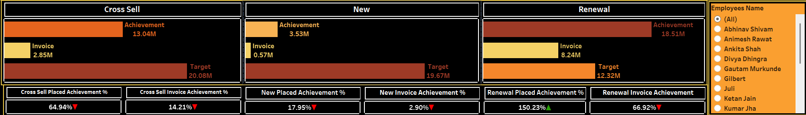
Analysis
Achievement: 13.04M vs. Target: 20.08M
Invoice: 2.85M
Achievement Rate:
Placed → 64.94%
Invoice → 14.21%
Invoice - Needs improvement in both placements and invoice conversion
Achievement: 18.51M vs. Target: 12.32M
Invoice: 8.24M
Achievement Rate:
Placed →150.23%
Invoice → 66.92%
Exceeding targets, great performance in renewals.
Filter to find out Employees performance for each KPIS’
Achievement: 3.53M vs. Target: 19.67M
Invoice: 0.57M
Achievement Rate:
Placed →17.95%
Invoice → 2.90%
Underperforming significantly, especially on invoicing.

Slide 7
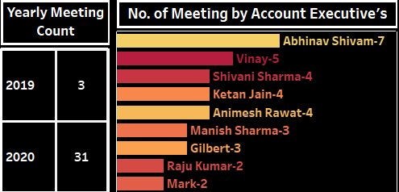
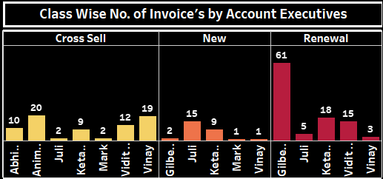
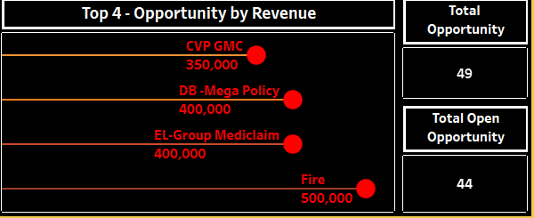
Analysis
It shows total counts of meeting conducted year wise.
Representation allows us for a quick comparison of the meeting activity among the different account executives. Abhinav Shivam has the highest number of meetings with 7 while Raju Kumar and Mark each have lowest number of 2 meetings.
Show case individual performance within each sales category, highlighting top performers and areas where certain individuals may excel or lag.
Cross Sell: Anim has the highest number of cross-sells with 20, while Juli and Mark each have lowest number of cross-sells with 2.
New: Juli leads in new sales with 15.
Renewal: Gilbe significantly outperforms others in renewals, with 61 renewals.
It shows count of Total Opportunity vs Open Opportunity.
Represents top 4 opportunities by revenue. "Fire" having the highest revenue, followed by "DB-Mega Policy" and "EL-Group Mediclaim", and "CVP GMC".

Slide 8
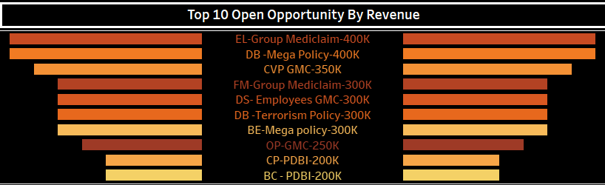
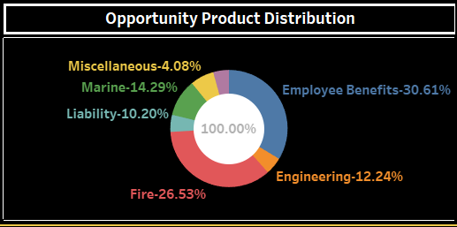
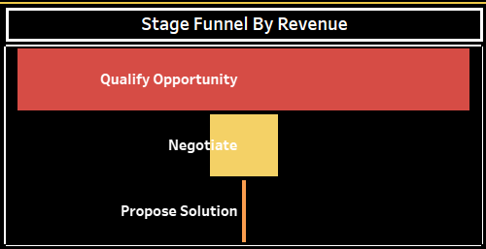
Analysis
Represents top 10 open opportunities by revenue.
Open opportunities are defined as deals currently in the "Propose Solution" or "Qualify Opportunity" stages
"EL-Group Mediclaim“ and "DB-Mega Policy“ having the highest revenue, followed by "CVP GMC".
Shows the distribution of opportunities across different product categories
Employee Benefits: 30.61%
Fire: 26.53%
Engineering: 12.24%
Marine: 14.29%
Liability: 10.20%
Miscellaneous: 4.08%
Shows progression of a sales process.
Qualify Opportunity stage Indicates the initial phase where potential opportunities are identified.
Negotiate stage represents the phase where terms and conditions are discussed and agreed upon.
Propose Solution is the final stage, shows the conversion initial identified opportunities result in a proposed solution.

Slide 9
Insights
Data highlights a strong performance in Renewals, exceeding targets, while Cross Sell and New Business significantly underperform, especially in invoice achievement.
A high number of open opportunities exist (44 out of 49 total), highlighting the need for proactive follow-up and deal closure.
Most revenue stuck in "Qualify Opportunity" stage. Very little reaching "Propose Solution" – possible bottleneck. Indicating a need for more aggressive follow-ups and closing strategies.

Slide 10

Recommendations'
Boost New Business Performance:
Investigate why new business is lagging far behind targets
Focus on Converting Qualified Opportunities:
A lot of potential revenue is stuck early in the funnel
Implement stronger sales follow-up and proposal mechanisms
Leverage Strong Performers:
Replicate Gilbert and Abhinav's tactics across the team. Consider peer mentoring or internal best practice sharing
Product Strategy:
Prioritize marketing and bundling of Employee Benefits and Fire policies
Analyze underperforming products (e.g., Miscellaneous, Marine) for potential phase-out or revamp
Targeted Training:
Upskill lower-performing team members
Launch loyalty program, enhance onboarding

Slide 11
CONCLUSION
Renewal Segment is the strongest performer, exceeding both placement and invoice targets.
Cross Sell and New Business segments are significantly underperforming, indicating the need for stronger lead and conversion strategies.
Gilbert and Abhinav Shivam stand out as key contributors. Their performance could serve as a model for team-wide improvement initiatives.
Employee Benefits and Fire insurance products drive the majority of revenue and should be focal points for future sales strategies and marketing efforts.
Actively pursue top 10 open opportunities to maximize near-term revenue.

Slide 12
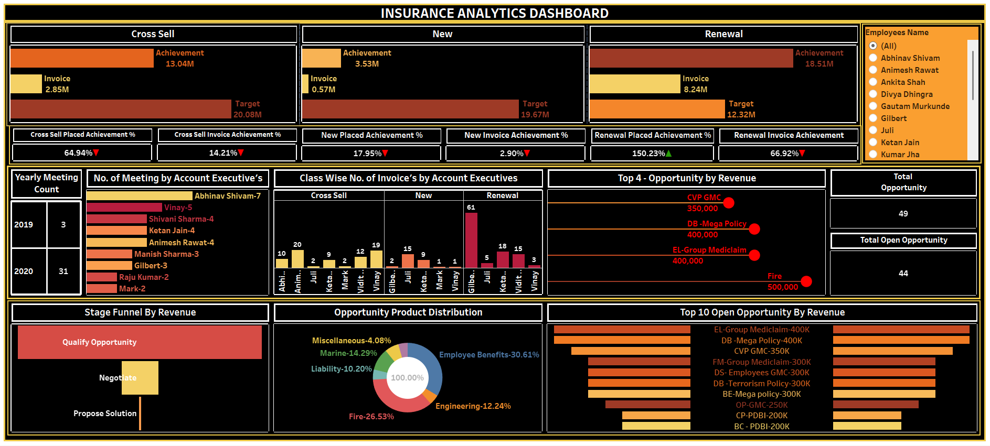
DASHBOARD

Slide 13


THANK YOU!!

